Slide 1

DIABETES PREDICTION SYSTEM
INTERNSHIP TASK-1

Slide 2
DIABETES PREDICTION SYSTEM
SOFTWARE REQUIREMENTS
Python
Anaconda
PyCharm IDE
Web Browser

Slide 3
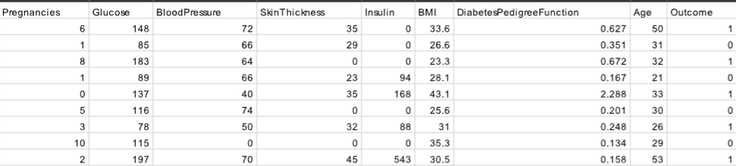
DIABETES PREDICTION SYSTEM
DATA

Slide 4
DIABETES PREDICTION SYSTEM
LIBRARIES & FRAMEWORK
Numpy
Pandas
Sklearn
Django

Slide 5
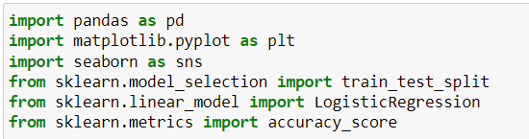
DIABETES PREDICTION SYSTEM
1. IMPORT LIBRARIES

Slide 6
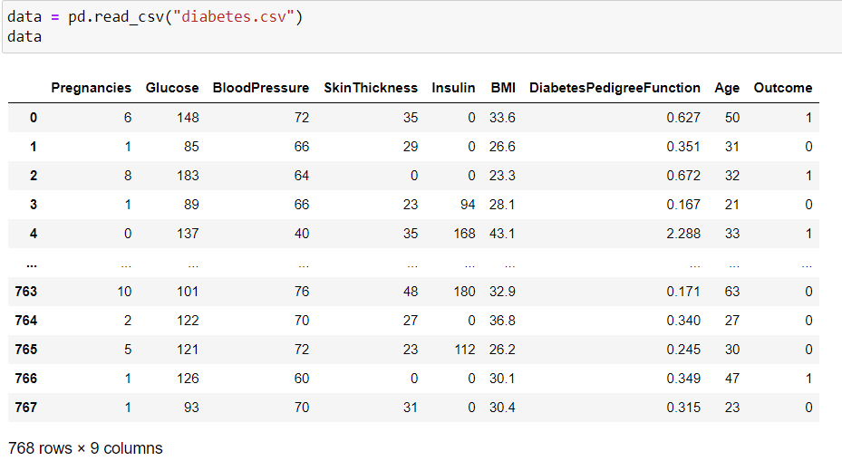
DIABETES PREDICTION SYSTEM
2. LOAD DATASET

Slide 7
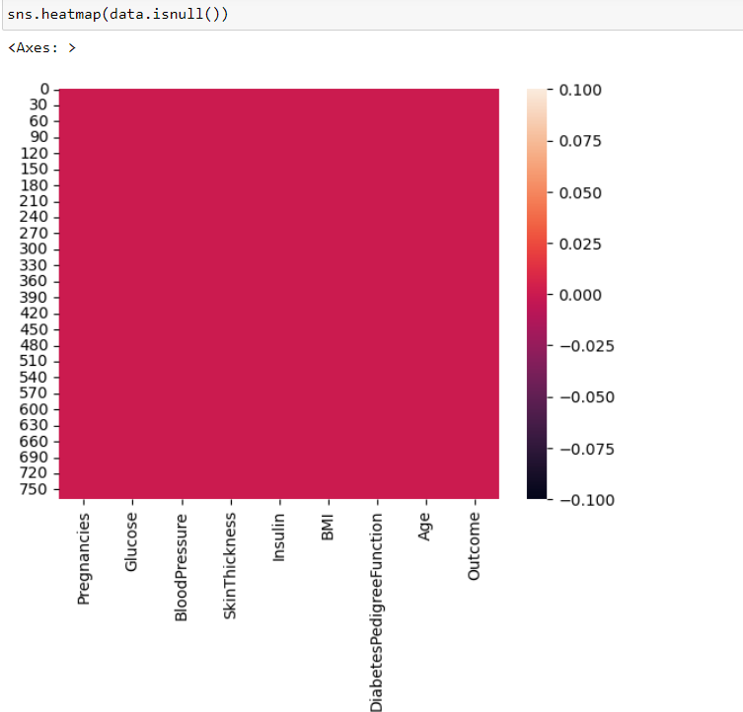
DIABETES PREDICTION SYSTEM
3. DATA EXPLORATION

Slide 8
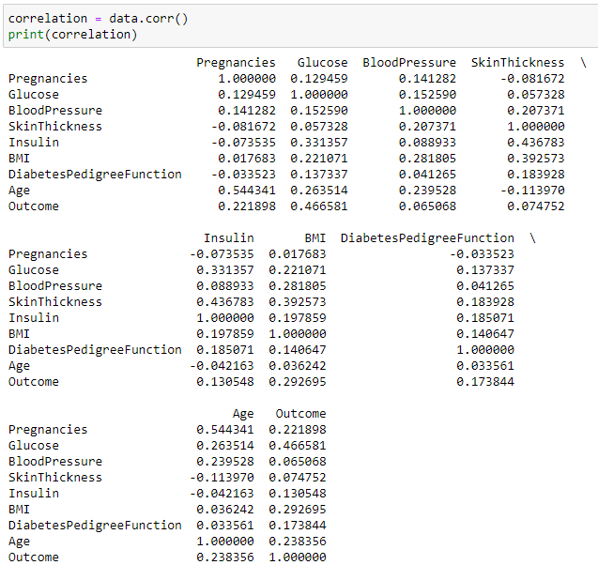
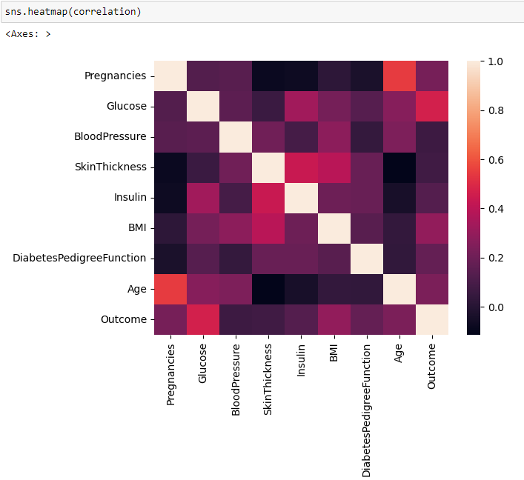
DIABETES PREDICTION SYSTEM
4. CORRELATION ANALYSIS

Slide 9
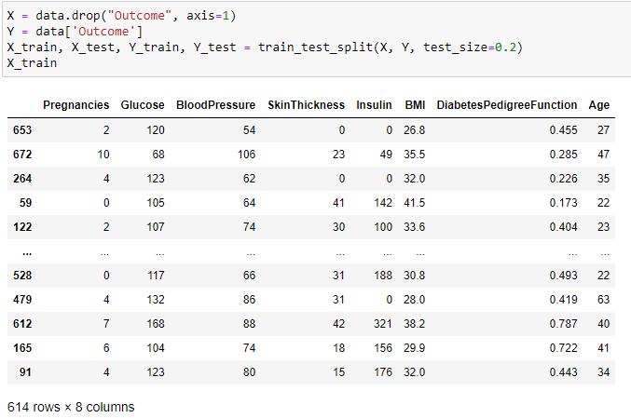
DIABETES PREDICTION SYSTEM
5. DATA SPLITTING

Slide 10

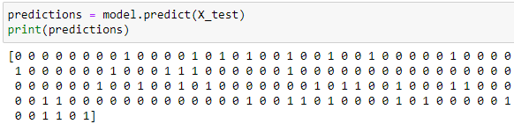

DIABETES PREDICTION SYSTEM
6. LOGISTIC REGRESSION MODEL

Slide 11

DIABETES PREDICTION SYSTEM
7. MODEL EVALUATION

